Slide 1
Crime in Chicago A Socioeconomic Exploration
Team Spicy Lime
Kanika Bhambi
Lazarus Goosby
Nick Hebert
Greg Rosen

Slide 2
Research Question
What is the relationship between socioeconomic factors
– such as income and education –
and crime in Chicago within the last five years?

Slide 3
Gathering the Data
City of Chicago Crime Dashboard
2013 - 2018
https://data.cityofchicago.org/Public-Safety/Crimes-2001-to-present-Dashboard/5cd6-ry5g
Point 2 Homes
2018
https://www.point2homes.com/US/Neighborhood/IL/Chicago.html

Slide 4
Grouping by Neighborhood
χ² test on arrests per capita in Chicago’s 77 neighborhoods
Null Hypothesis
Each neighborhood composed of similar populations
These populations produce the same number of arrests per capita as the city of Chicago
Critical Value
95% confidence with 76 degrees of freedom
97.35
χ² Statistic
Σ (Actual Arrests_{neighborhood} – Expected Arrests_{neighborhood})²
1,701,608.94
p-value
0.0
Conclusion
The neighborhoods are decidedly not composed of similar populations

Slide 5
ANALYSIS

Slide 6
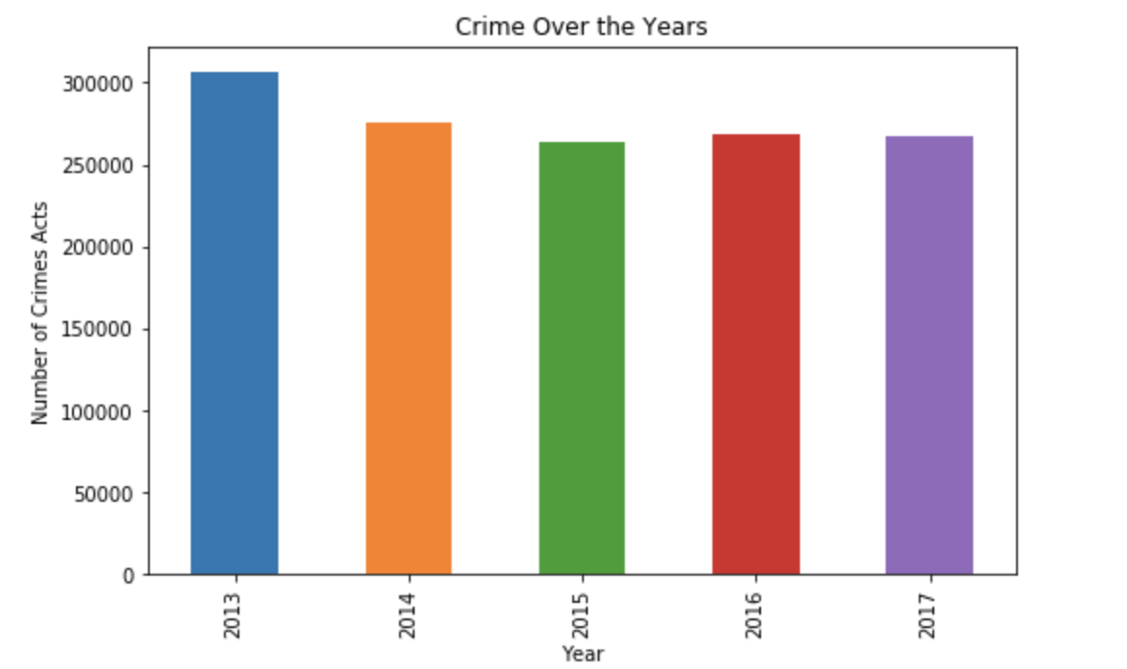
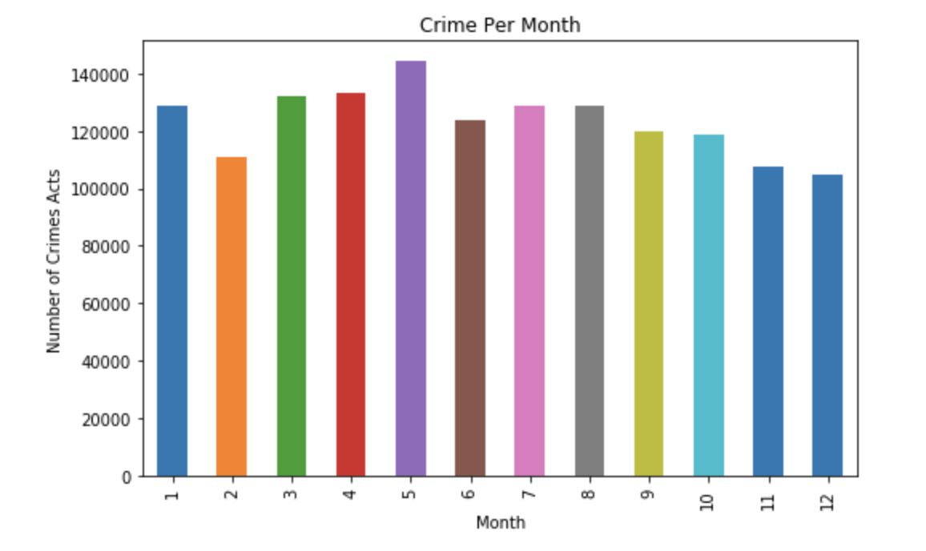
Crime in Chicago through the course of time

Slide 7
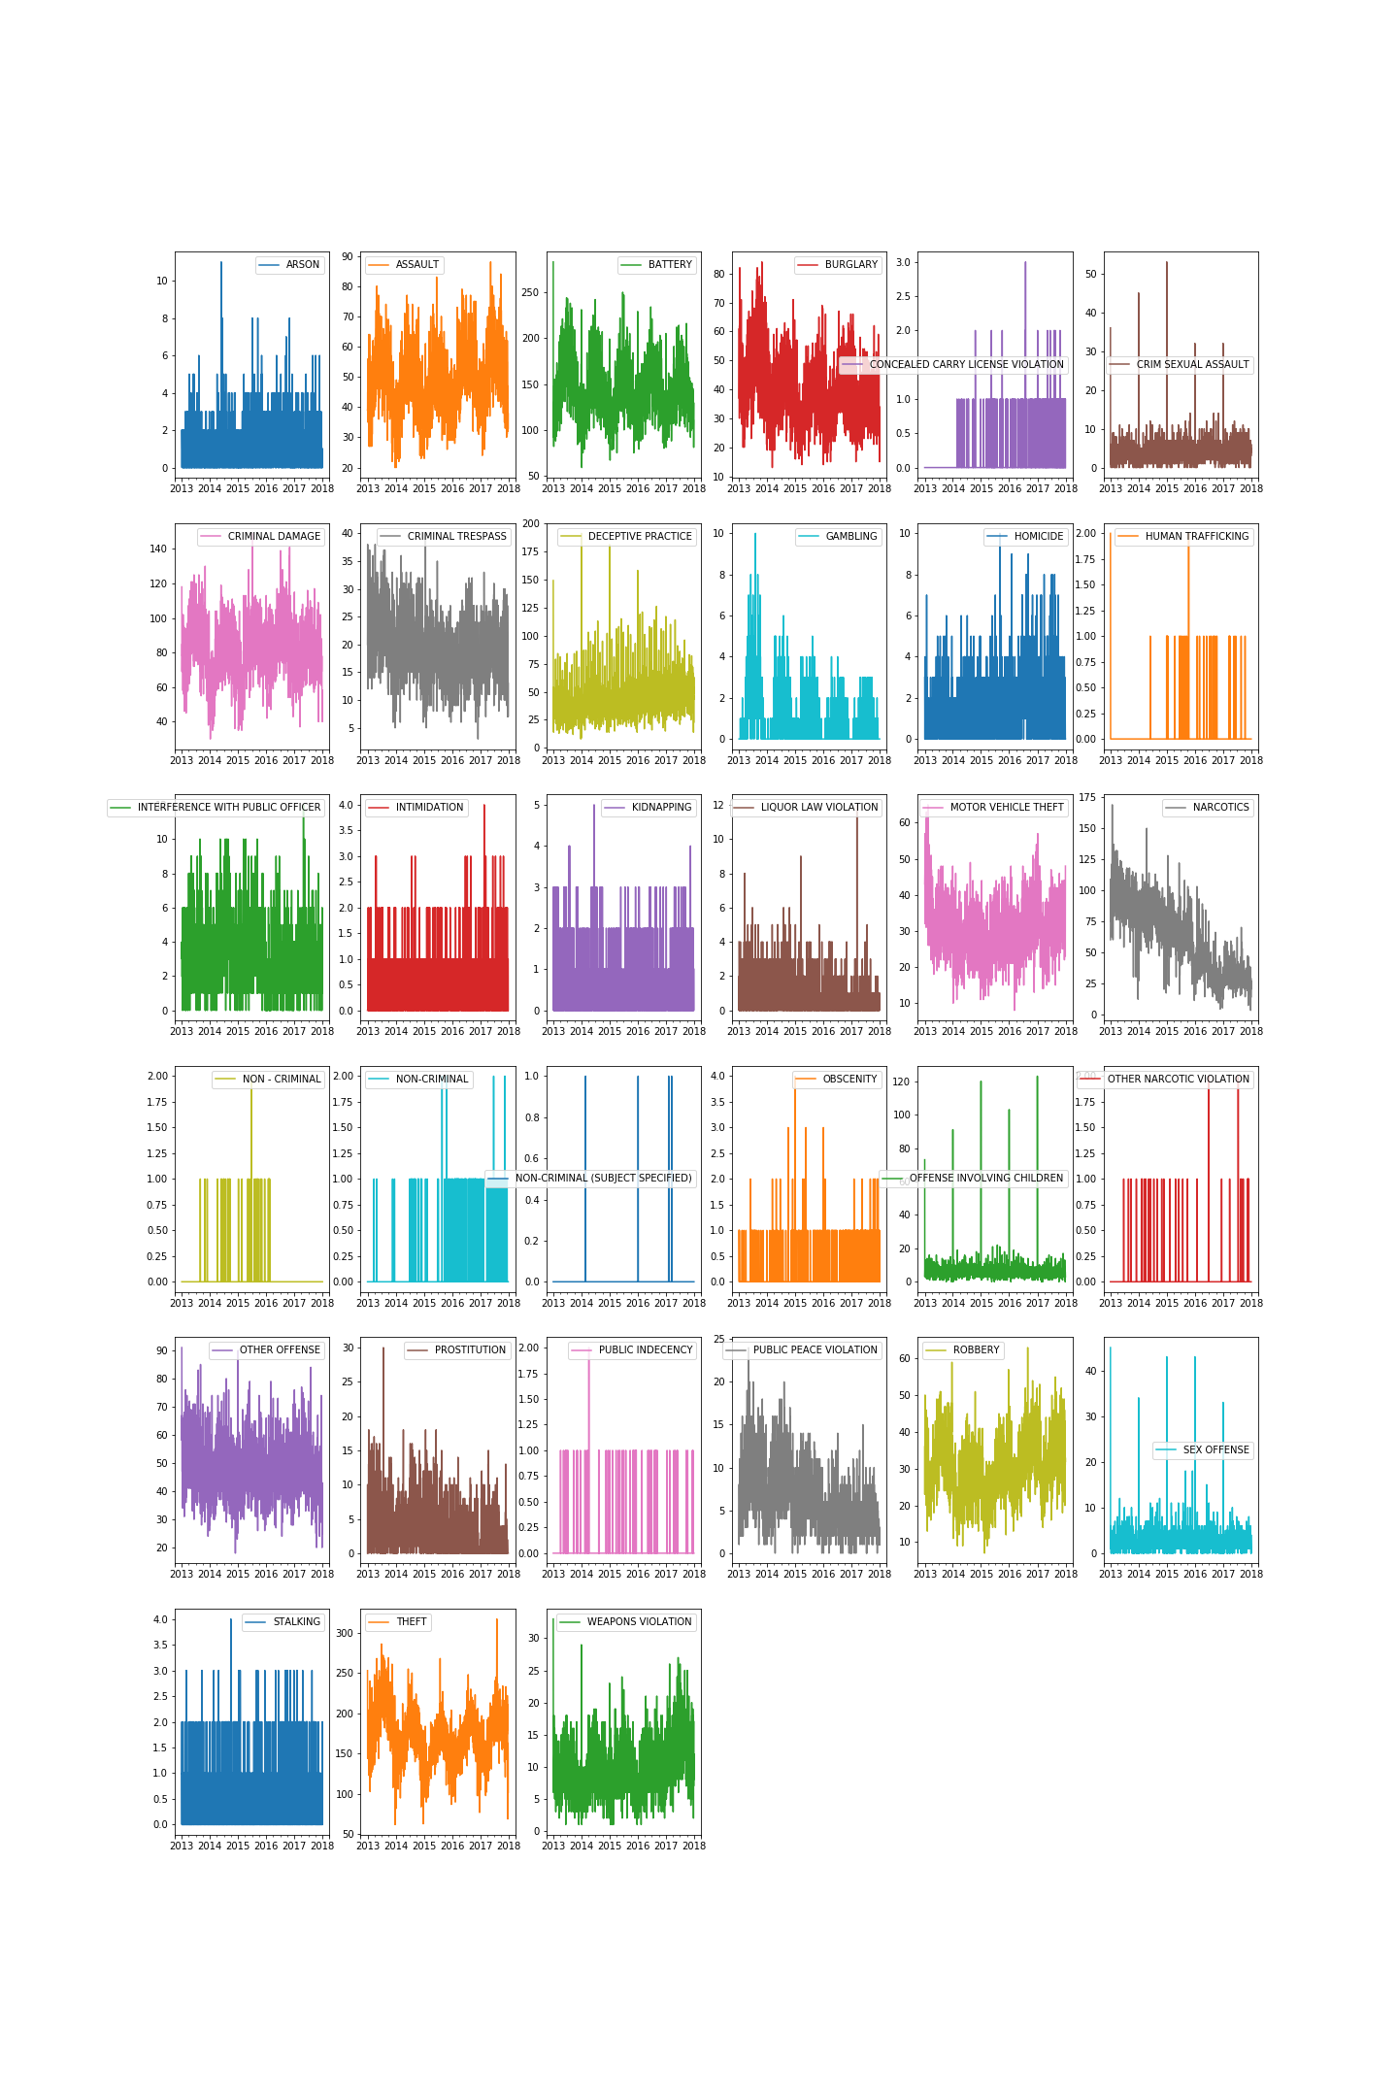
Crime in Chicago through the course of time

Slide 8
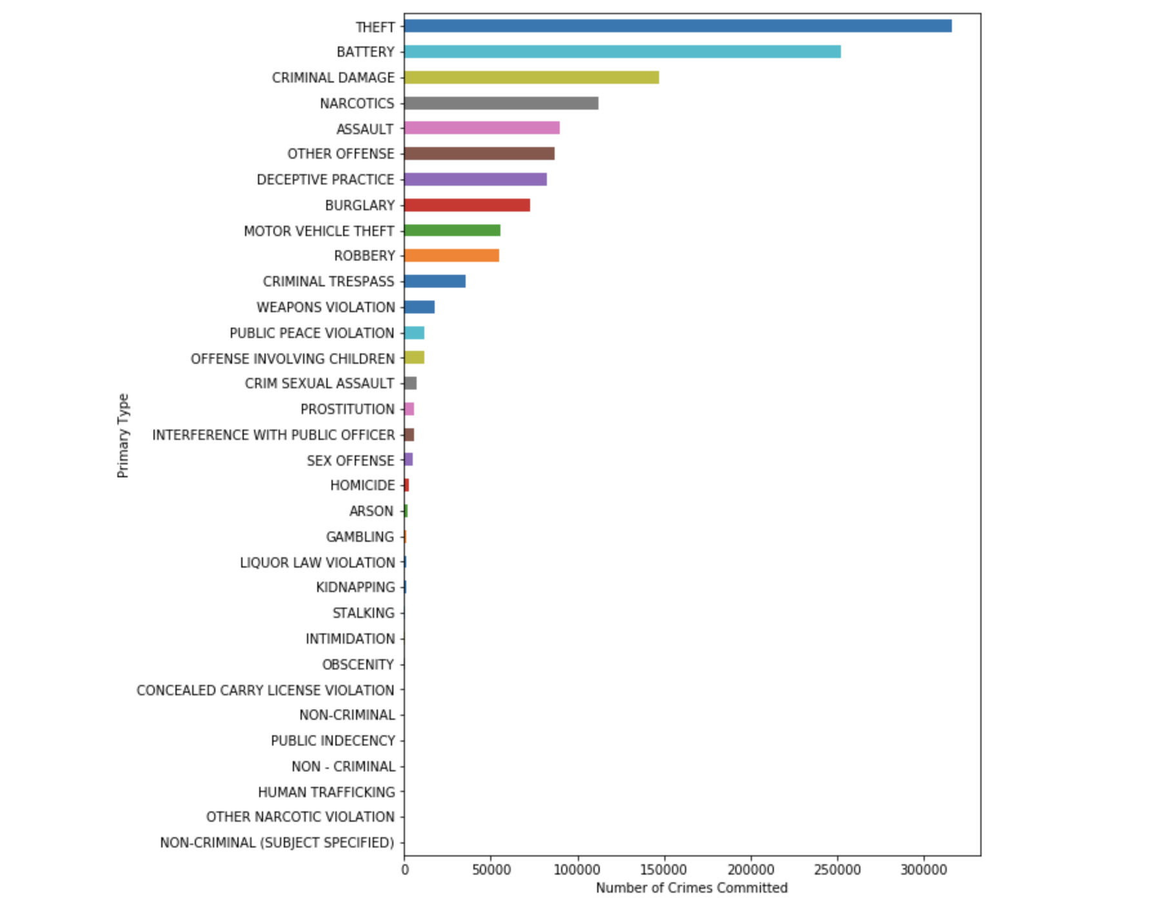
Type of Crime

Slide 9
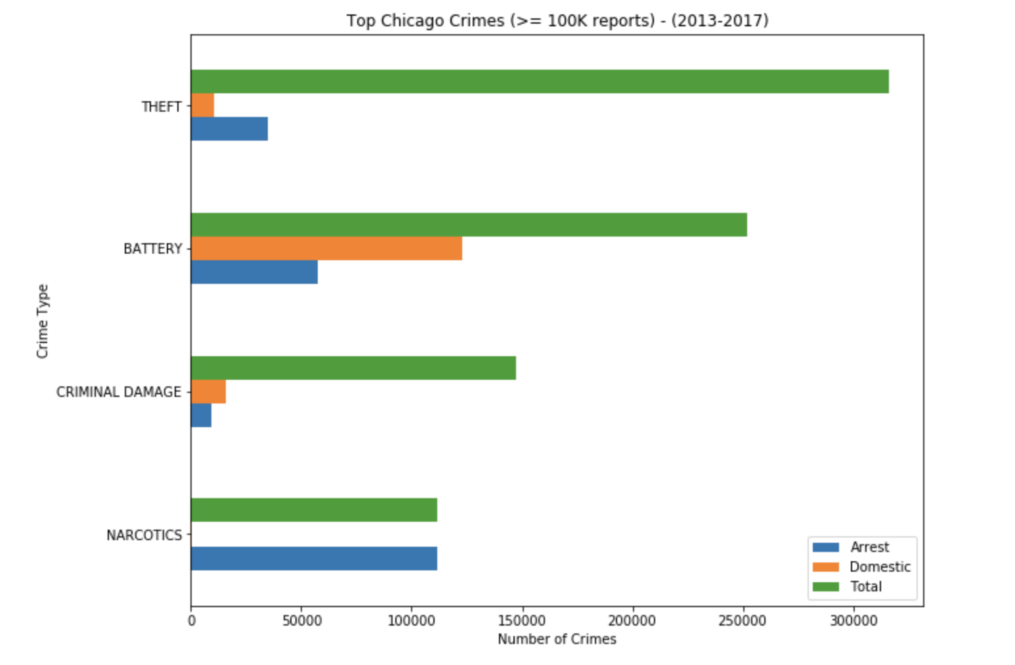
Top Crime in Chicago

Slide 10
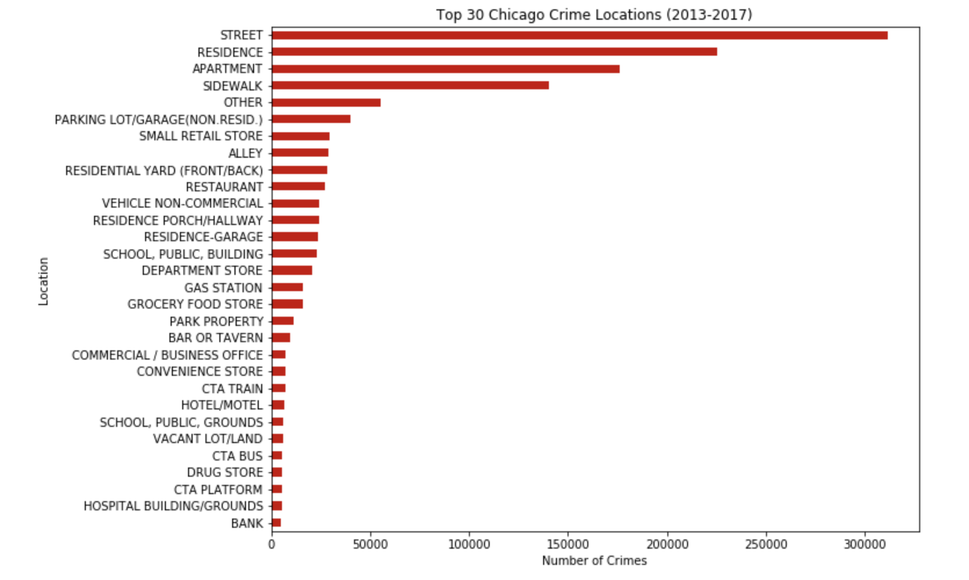
Crime by location

Slide 11
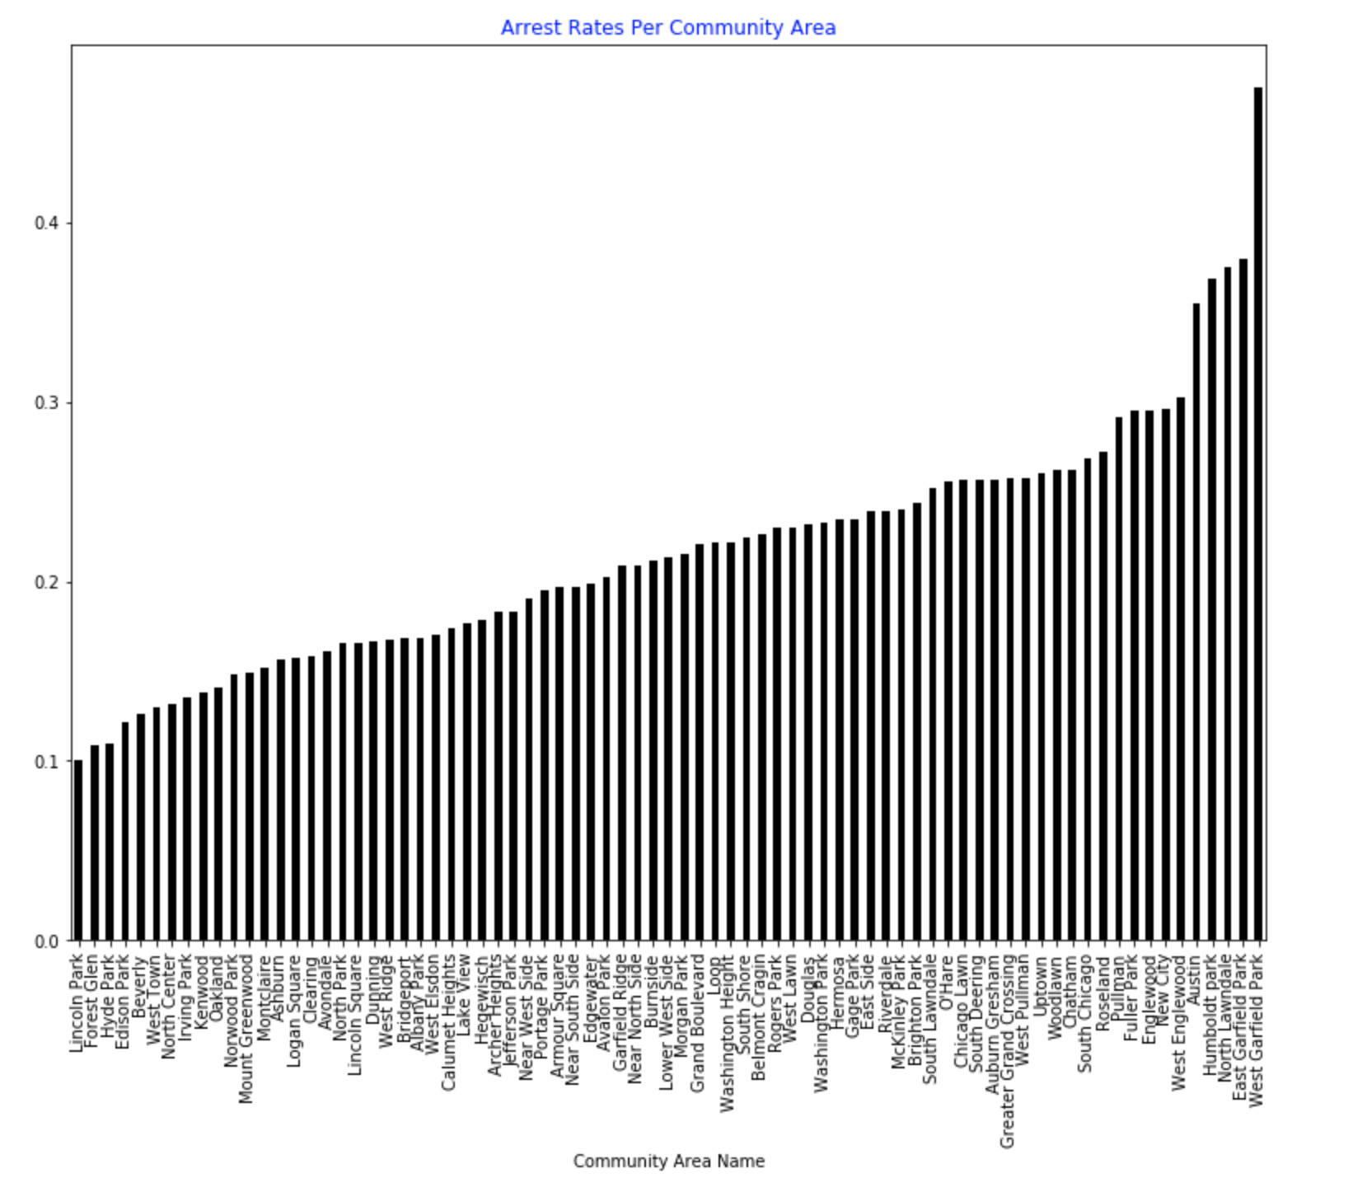
Arrest Rates by Community Area

Slide 12
New Slide
Grouping 1
Grouping 2
Grouping 3

